Slide 1

Stack and Queue
SoftUni Team
Technical Trainers
Software University
https://softuni.bg

Slide 2
Table of Contents
Algorithmic Complexity
Stack - Last In First Out (LIFO)
Stack Functionality
Java Stack Implementation
Overview of All Operations
Queue - First In First Out(FIFO)
Queue Functionality
Queue Implementation
Overview of All Operations
Priority Queue

Slide 3
Have a Question?
sli.do
#java-advanced

Slide 4

Algorithmic Complexity

Slide 5
Algorithmic Complexity
Describes performance of particular algorithm
Runtime and memory consumption based on the input size N
We usually care about the worst-case performance
We measure the complexity as the Big O notation
Numerical function depending on the input size O(N)
We measure time as the number of simple steps
We measure memory as input data N by it's type size

Slide 6
Algorithmic Complexity
O(1) – Constant time – time does not depend on N
O(log(N)) – Logarithmic time – grows with rate as log(N)
O(N) – Linear time grows at the same rate as N
O(N^2),O(N^3) – Quadratic, Cubic grows as square or cube of N
O(2^N) – Exponential grows as N becomes the exponent worst algorithmic complexity
For input size of 10 - 1024 steps
For input size of 100 – 1267650600228229401496703205376 steps
http://bigocheatsheet.com/

Slide 7
Asymptotic Functions
Below are some examples of common algorithmic grow:

Slide 8
Get Sum Number of Steps
Calculate maximum steps to find sum of even elements in an array
Assume that a single step is a single CPU instruction:
assignments, array lookups, comparisons, arithmetic operations
Solution:
T(n) = 9n + 3
int getSumEven(int[] array) {
int sum = 0;
for (int i = 0; i < array.length; i++)
if (array[i] % 2 == 0) sum += array[i];
return sum;
}
Counting maximum steps is called worst-case analysis

Slide 9
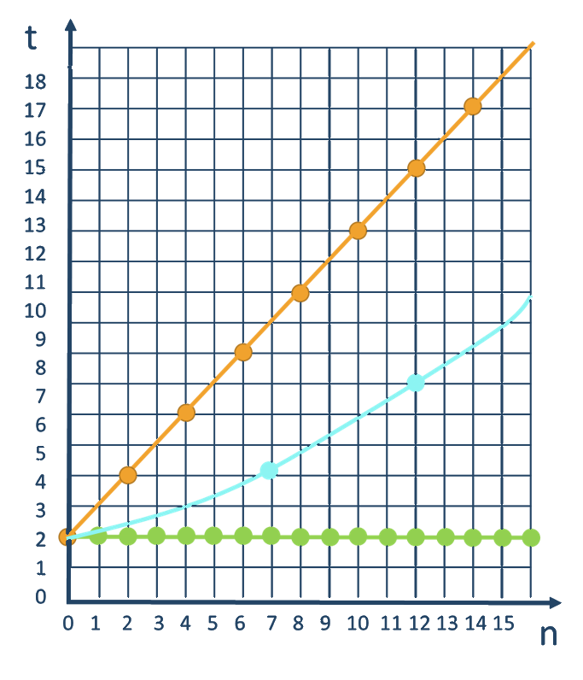
Time Complexity
Worst-case
An upper bound on the running time
Average-case
Average running time
Best-case
The lower bound on the running time (the optimal case)

Slide 10
Stacks and Queue vs. ArrayDeque
Why don't use Stack and Queue?
Implementation details which make unsecure usability
In many cases those structures will decrease the performance
Why to use ArrayDeque?
Implementation which makes the structure more secure
Better performance and usability
Methods which operate as those structures suggest

Slide 11
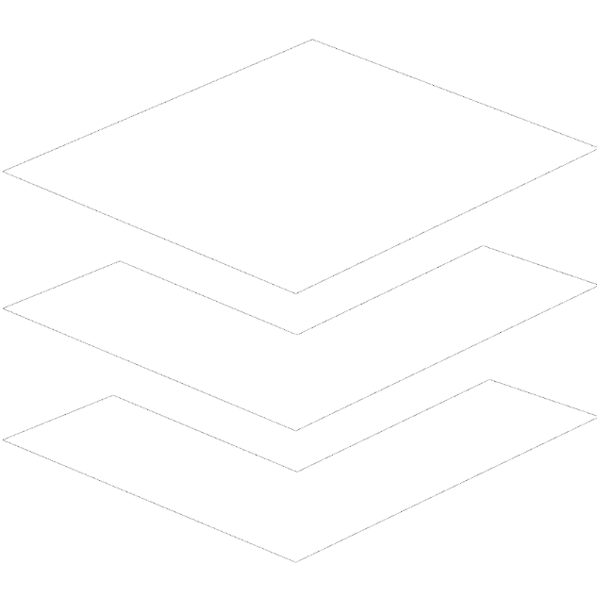
Stack

Slide 12
Stack Functionality
Stacks provide the following functionality:
Pushing an element at the top of the stack
Popping element from the top of the stack
Getting the topmost element without removing it
10
10
10
5
5
5
2
2
2
Push
Pop
Peek
12

Slide 13
ArrayDeque<E> – Java Stack Implementation
Creating a Stack
Adding elements at the top of the stack
Removing elements
Getting the value of the topmost element
ArrayDeque<Integer> stack = new ArrayDeque<>();
stack.push(element);
Integer element = stack.pop();
Integer element = stack.peek();

Slide 14
Stack – Utility Methods
ArrayDeque<Integer> stack = new ArrayDeque<>();
int size = stack.size();
boolean isEmpty = stack.isEmpty();
boolean exists = stack.contains(2);

Slide 15
Stack – Overview of All Operations
10
5
5
2
15
-7
132
Stack<Integer>
push()
2
0
1
3
4
pop()
size():
5
5
peek()

Slide 16
Problem: Browser History
Write a program which takes 2 types of browser instructions:
Normal navigation: a URL is set, given by a string
The string "back" that sets the current URL to the last set URL
Input
Output
https//softuni.bg/
back
https//softuni.bg/trainings/courses
back
https//softuni.bg/trainings/2056
back
https//softuni.bg/trainings/live
https//softuni.bg/trainings/live/details
Home
https//softuni.bg/
no previous URLs
https//softuni.bg/trainings/courses
https//softuni.bg/
https//softuni.bg/trainings/2056
https//softuni.bg/
https//softuni.bg/trainings/live
https//softuni.bg/trainings/live/details

Slide 17
Solution: Browser History (1)
Scanner scanner = new Scanner(System.in);
ArrayDeque<String> browser = new ArrayDeque<>();
String line = scanner.nextLine();
String current = "";
// continue…
Check your solution here: https://judge.softuni.bg/Contests/1437/Stacks-and-Queues-Lab
17

Slide 18
Solution: Browser History (2)
while(!line.equals("Home")) {
if(line.equals("back")) {
if(!browser.isEmpty()) { current = browser.pop();
} else {
System.out.println("no previous URLs");
line = scanner.nextLine();
continue; }
} else {
if(!current.equals("")) { browser.push(current); }
current = line; }
System.out.println(current);
line = scanner.nextLine(); }
18

Slide 19
Problem: Simple Calculator
Implement a simple calculator that can evaluate simple expressions (only addition and subtraction)
Input
Output
2 + 5 + 10 - 2 - 1
14
2 - 2 + 5
5
Check your solution here: https://judge.softuni.bg/Contests/1437/Stacks-and-Queues-Lab

Slide 20
Solution: Simple Calculator (1)
Scanner scanner = new Scanner(System.in);
String[] tokens = scanner.nextLine().split("\\s+");
Deque<String> stack = new ArrayDeque<>();
Collections.addAll(stack, tokens);
// continues…
Split by regex
Adds a collection to another collection
Check your solution here: https://judge.softuni.bg/Contests/1437/Stacks-and-Queues-Lab

Slide 21
Solution: Simple Calculator (2)
while (stack.size() > 1) {
int first = Integer.valueOf(stack.pop());
String op = stack.pop();
int second = Integer.valueOf(stack.pop());
switch (op)
case "+": stack.push(String.valueOf(first + second));
break;
case "-": stack.push(String.valueOf(first - second));
break;
}
System.out.println(stack.pop());
Check your solution here: https://judge.softuni.bg/Contests/1437/Stacks-and-Queues-Lab

Slide 22
Problem: Decimal to Binary Converter
Create a converter which takes a decimal number and converts it into a binary number
Input
Output
10
1010
1024
10000000000
Check your solution here: https://judge.softuni.bg/Contests/1437/Stacks-and-Queues-Lab

Slide 23
Solution: Decimal to Binary Converter
Scanner scanner = new Scanner(System.in);
int decimal = Integer.valueOf(scanner.nextLine());
ArrayDeque<Integer> stack = new ArrayDeque<>();
// TODO: check if number is 0
while (decimal != 0)
stack.push(decimal % 2);
decimal /= 2;
while (!stack.isEmpty())
System.out.print(stack.pop());
Check your solution here: https://judge.softuni.bg/Contests/1437/Stacks-and-Queues-Lab
23

Slide 24
Problem: Matching Brackets
We are given an arithmetical expression with brackets (with nesting)
Goal: extract all sub-expressions in brackets
1 + (2 - (2 + 3) * 4 / (3 + 1)) * 5
(2 + 3)
(3 + 1)
(2 - (2 + 3) * 4 / (3 + 1))
Check your solution here: https://judge.softuni.bg/Contests/1437/Stacks-and-Queues-Lab

Slide 25
Solution: Matching Brackets (1)
Scanner scanner = new Scanner(System.in);
String expression = scanner.nextLine();
Deque<Integer> stack = new ArrayDeque<>();
// continue…
Check your solution here: https://judge.softuni.bg/Contests/1437/Stacks-and-Queues-Lab

Slide 26
Solution: Matching Brackets (2)
for (int i = 0; i < expression.length(); i++) {
char ch = expression.charAt(i);
if (ch == '(')
stack.push(i);
else if (ch == ')')
int startIndex = stack.pop();
String contents = expression.substring(startIndex, i + 1);
System.out.println(contents);
}
Check your solution here: https://judge.softuni.bg/Contests/1437/Stacks-and-Queues-Lab

Slide 27

Queues

Slide 28
Queue
First In First Out
2
5
10

Slide 29
Queue – Abstract Data Type
Queues provide the following functionality:
Adding an element at the end of the queue
Removing the first element from the queue
Getting the first element of the queue without removing it
2
5
10
2
5
10
2
5
10

Slide 30
ArrayDeque<E> – Java Queue Implementation
Creating a Queue
Adding elements at the end of the queue
add() – throws exception if queue is full
offer() – returns false if queue is full
ArrayDeque<Integer> queue = new ArrayDeque<>();
queue.add(element);
queue.offer(element);

Slide 31
ArrayDeque<E> – Java Queue Implementation (2)
Removing elements
remove() - throws exception if queue is empty
poll() - returns null if queue is empty
Check first element
element = queue.remove();
element = queue.poll();
element = queue.peek();

Slide 32
Add() / Offer()
Adds an element to the queue
4
2
3
1
Queue<Integer>
size():
0
-3
15
121
5

Slide 33
Remove() / Poll()
Returns and removes first element
4
2
size():
3
Queue<Integer>
121
15
-3
5

Slide 34
Problem: Hot Potato
Children form a circle and pass a hot potato clockwise
Every n^{th} toss a child is removed until only one remains
Upon removal the potato is passed forward
Print the child that remains last
Input
Output
Sam John Sara
2
Removed John
Removed Sam
Last is Sara
Check your solution here: https://judge.softuni.bg/Contests/1437/Stacks-and-Queues-Lab

Slide 35
Solution: Hot Potato (1)
Scanner scanner = new Scanner(System.in);
String[] children = scanner.nextLine().split("\\s+");
int n = Integer.valueOf(scanner.nextLine());
ArrayDeque<String> queue = new ArrayDeque<>();
for (String child : children)
queue.offer(child);
// continue…
Check your solution here: https://judge.softuni.bg/Contests/1437/Stacks-and-Queues-Lab

Slide 36
Solution: Hot Potato (2)
while (queue.size() > 1) {
for (int i = 1; i < n; i++)
queue.offer(queue.poll());
System.out.println("Removed " + queue.poll());
}
System.out.println("Last is " + queue.poll());
Check your solution here: https://judge.softuni.bg/Contests/1437/Stacks-and-Queues-Lab

Slide 37
ArrayDeque<E> – Java Queue Implementation (3)
Utility Methods
peek() - checks the value of the first element
size() - returns queue size
toArray() - converts the queue to an array
contains() - checks if element is in the queue
Integer element = queue.peeк();
Integer size = queue.size();
Integer[] arr = queue.toArray();
boolean exists = queue.contains(element);

Slide 38
Peek()
Gets the first element without removing it
size():
2
Queue<Integer>
121
15
15

Slide 39
Problem: Math Potato
Rework the previous problem so that a child is removed only on a prime cycle (cycles start from 1)
If a cycle is not prime, just print the child's name
Input
Output
Maria Peter George
2
Removed Peter
Prime Maria
Prime George
Removed Maria
Last is George
Check your solution here: https://judge.softuni.bg/Contests/1437/Stacks-and-Queues-Lab

Slide 40
Solution: Math Potato
int cycle = 1;
while (queue.size() > 1) {
for (int i = 1; i < n; i++)
queue.offer(queue.poll());
if (isPrime(cycle))
System.out.println("Prime " + queue.peek());
else
System.out.println("Removed " + queue.poll());
cycle++;
}
System.out.println("Last is " + queue.poll());
Check your solution here: https://judge.softuni.bg/Contests/1437/Stacks-and-Queues-Lab

Slide 41
Queue – Overview of All Operations
4
0
1
2
size():
3
Queue<Integer>
-3
15
121
15
5
5
add()
peek()
remove()

Slide 42
Priority Queue
Retains a specific order to the elements
Higher priority elements are pushed to the beginning of the queue
Lower priority elements are pushed to the end of the queue
A
B
C

Slide 43

Summary
…
…
…
Algorithmic Complexity
Stack - Last In First Out (LIFO)
push(), pop(), peek()
Queue - First In First Out (FIFO)
add(), poll(), peek()
Priority Queue

Slide 44
Questions?
Notes:
44

Slide 45











SoftUni Diamond Partners

Slide 46
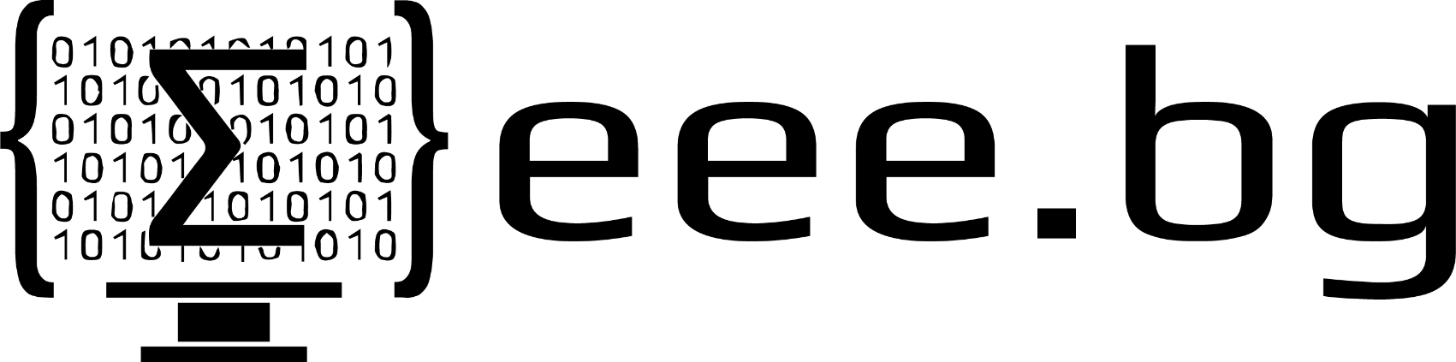

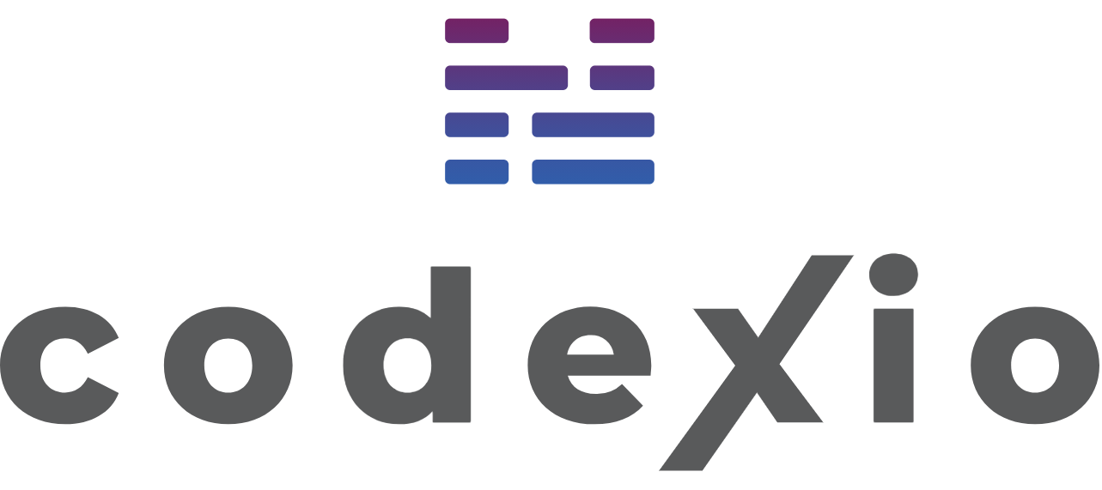
Educational Partners

Slide 47
Trainings @ Software University (SoftUni)
Software University – High-Quality Education, Profession and Job for Software Developers
softuni.bg
Software University Foundation
softuni.foundation
Software University @ Facebook
facebook.com/SoftwareUniversity
Software University Forums
forum.softuni.bg
47
Notes:
47

Slide 48

License
This course (slides, examples, demos, exercises, homework, documents, videos and other assets) is copyrighted content
Unauthorized copy, reproduction or use is illegal
© SoftUni – https://about.softuni.bg
© Software University – https://softuni.bg
Notes:
48

